Slide 1
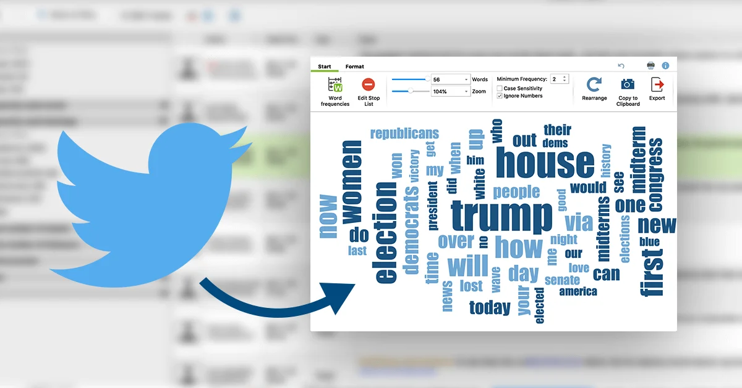
SENTIMENT ANALYSIS
TWITTER DATA ANALYSIS

Slide 2

Project presented by: SNEHA B VIDYASAGAR M VISHNU A
Trainer Mrs. Amruta Chimote (Edubridge learning pvt.ltd) 2021 - 2022

Slide 3
About project
Aim : To keep track of what's being said about your product or service on social media, and can help you detect angry customers or negative mentions before they they escalate.
Objectives : Analyze data to find tweets are influencing positively or negatively .
Data Source : Kaggle

Slide 4
contents
INTRODUCTION
CHALLENGES
DATA COLLECTION & PREPROCESSING
Importing Libraries
Importing Dataset
Shape of the Data
Exploratory Data Analysis
Dataset Details
PREPROCESSING OF PREDICTION MODEL
PREDICTION MODEL
DATA VISUALIZATION
Result & discussion
CONCLUSION

Slide 5
INTRODUCTION
Sentiment Analysis is a technique widely used in text mining. Twitter Sentiment Analysis, therefore means, using advanced text mining techniques to analyze the sentiment of the text (here, tweet) in the form of positive, negative and neutral. It is also known as Opinion Mining, is primarily for analyzing conversations, opinions, and sharing of views (all in the form of tweets) for deciding business strategy, political analysis, and also for assessing public actions.

Slide 6


CHALLENGES
TONE
POLARITY
SARCASM
EMOJIS
NEGATIONS
EMPLOYEE BIAS

Slide 7


DATA COLLECTION & PREPROCESSING
Importing libraries
NLP & NLTK - Used for Preprocessing Data
Numpy & Pandas - Used for EDA
Seaborn & Matplotlib - Used for visualization
Sklearn - Used for creating prediction model
Importing dataset
“sentiment_tweets3.csv” using “pd.read_csv” and saving it to variable “df”
Shape of the data
10313 rows & 3 columns using using ‘data.shape’

Slide 8

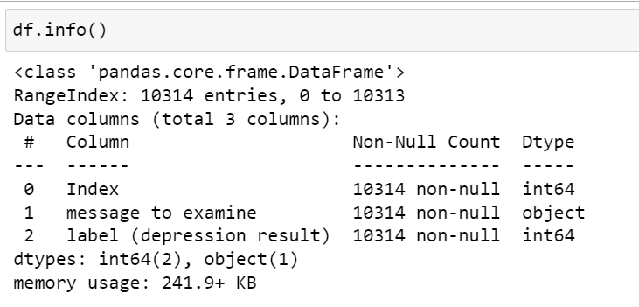
Exploratory Data Analysis
Dataset Details
Column names & datatypes
using ‘df.info()’
2 integers
1 object

Slide 9
PREPROCESSING OF DATA
Lowercasing All the Tweets
Removing ‘web links’ , ’twitter mentions’ , ’punctuations’
Removal of ‘Stopwords’
Lemmatization

Slide 10
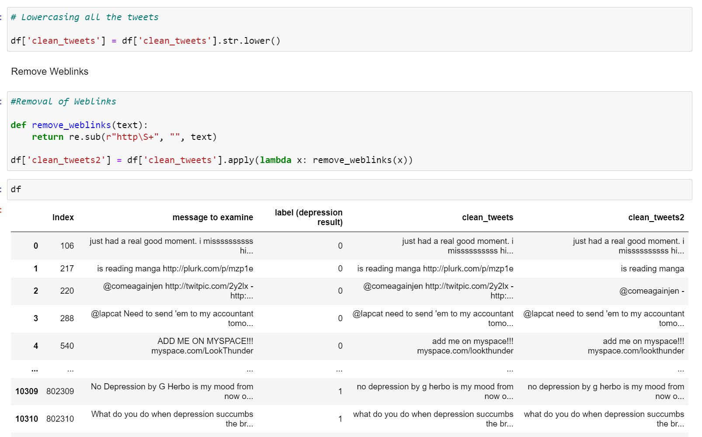
Lowercasing All the Tweets & Removing ‘web links’

Slide 11
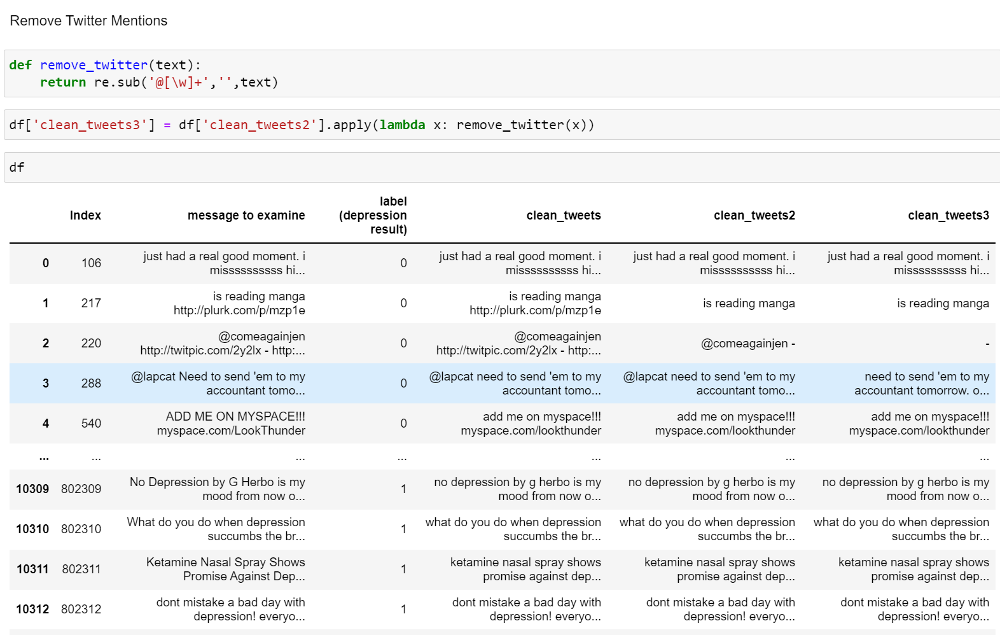
Removal of ’twitter mentions’

Slide 12
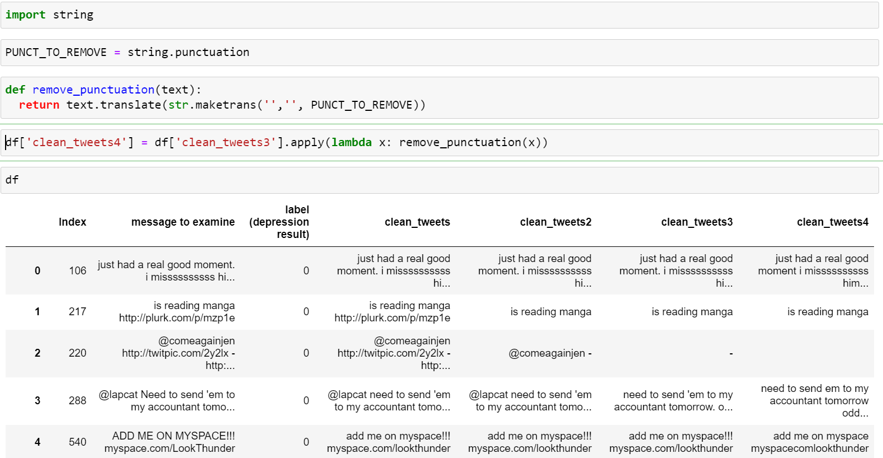
Removal of ’punctuations’

Slide 13
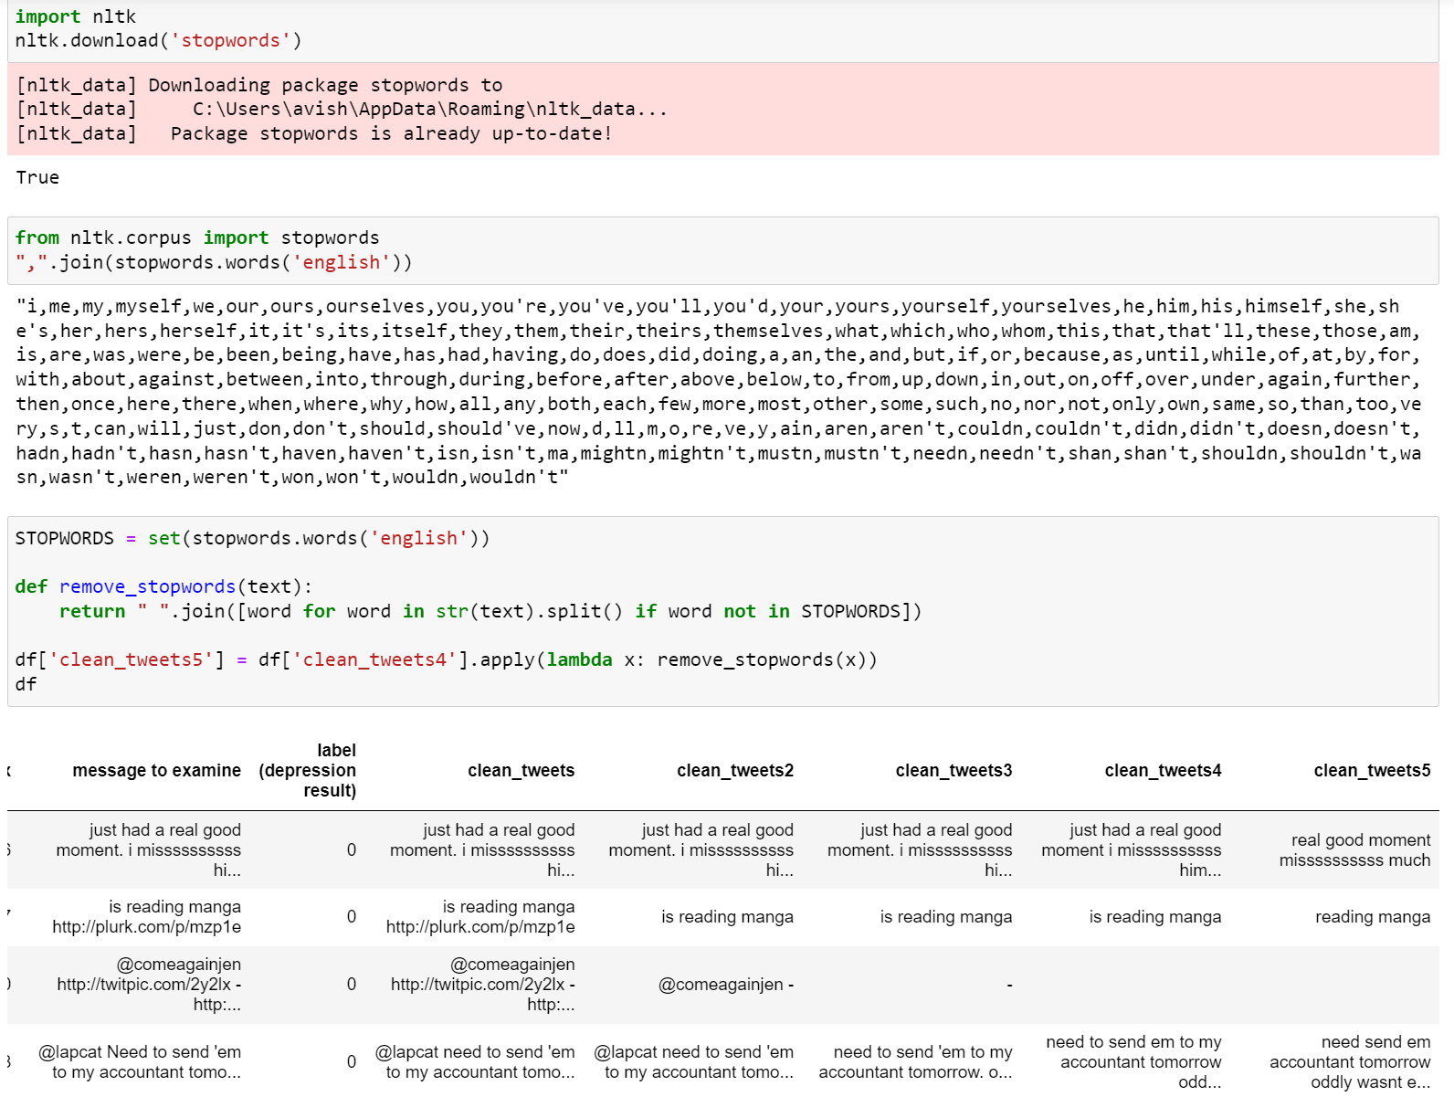
Removal of ‘Stopwords’

Slide 14
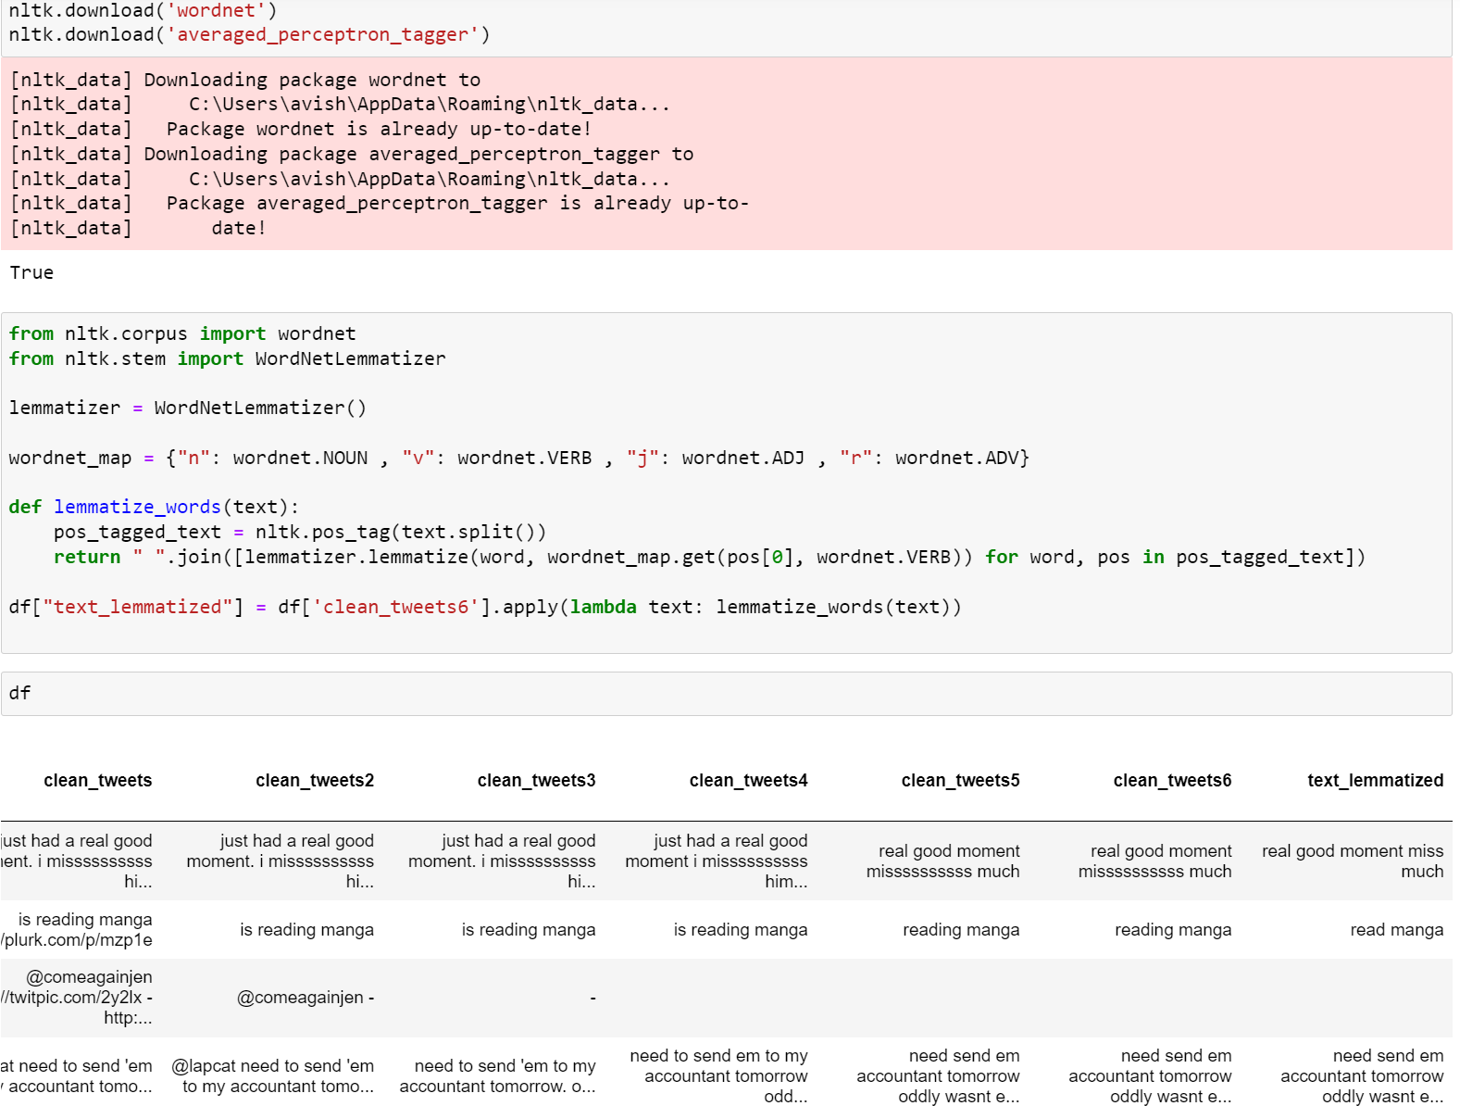
Lemmatization

Slide 15
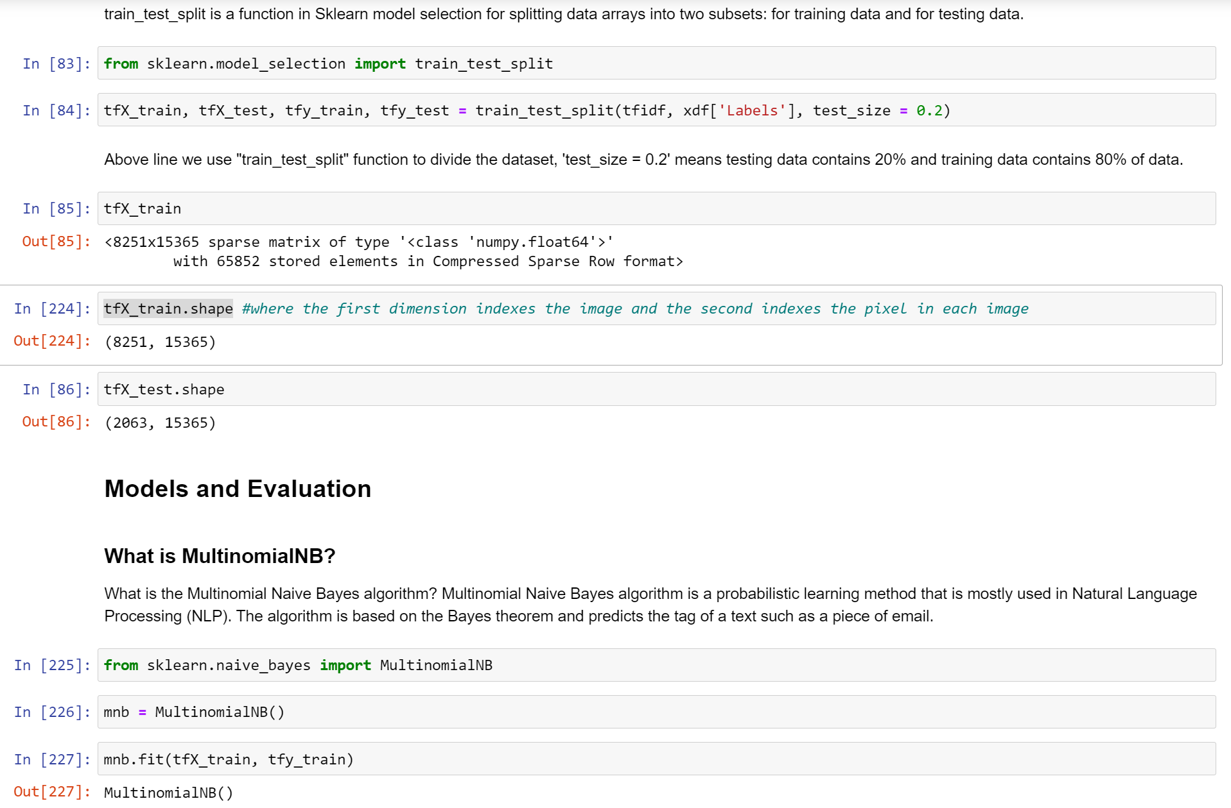
PREDICTION MODEL

Slide 16
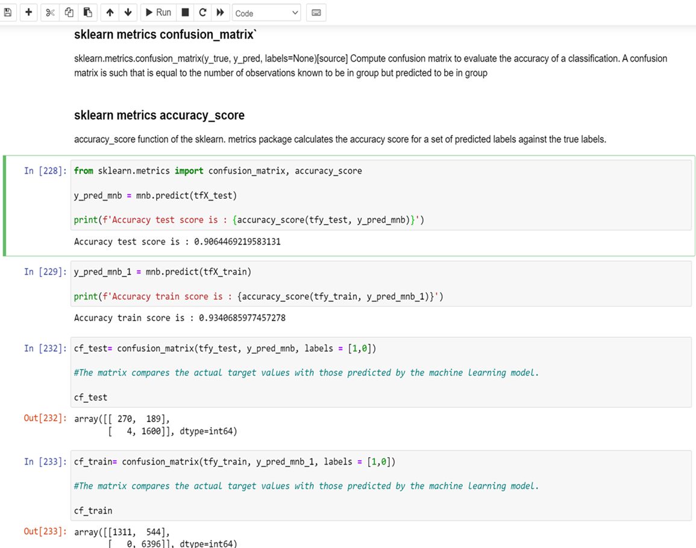

Slide 17
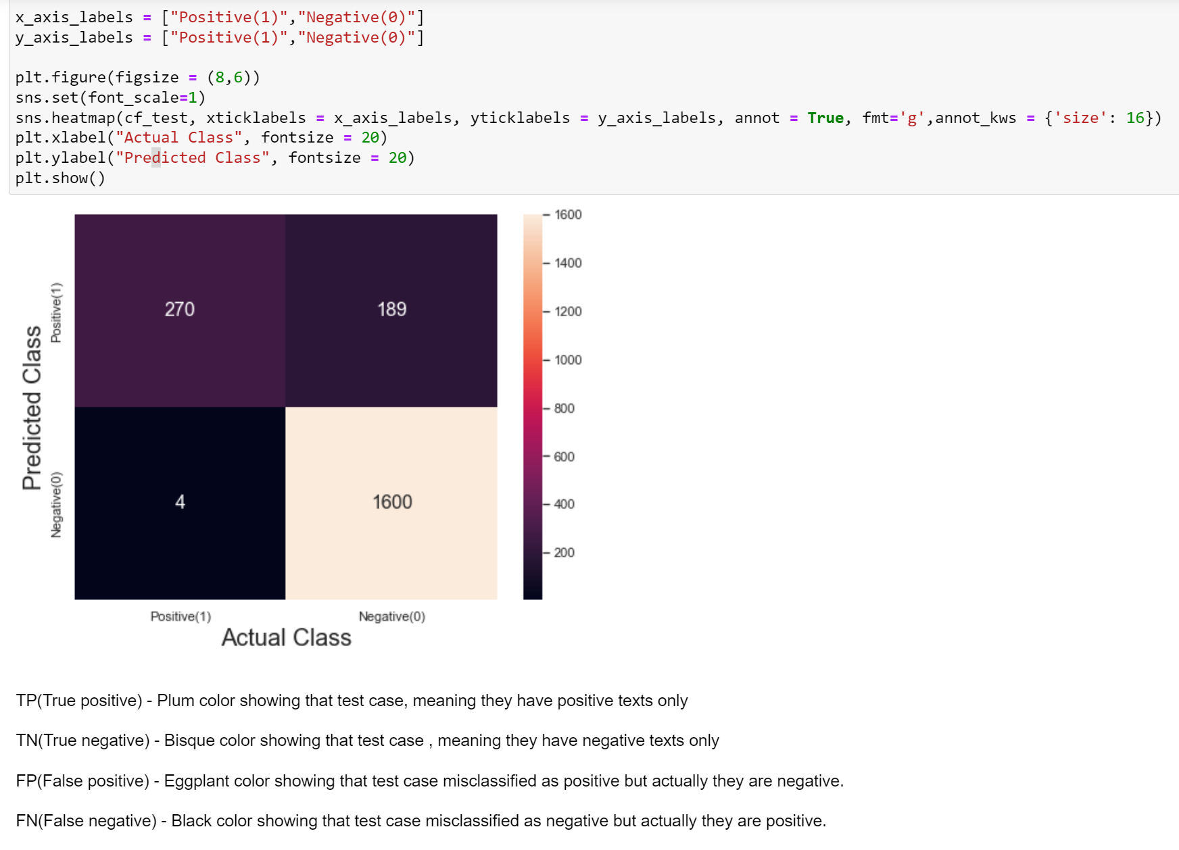
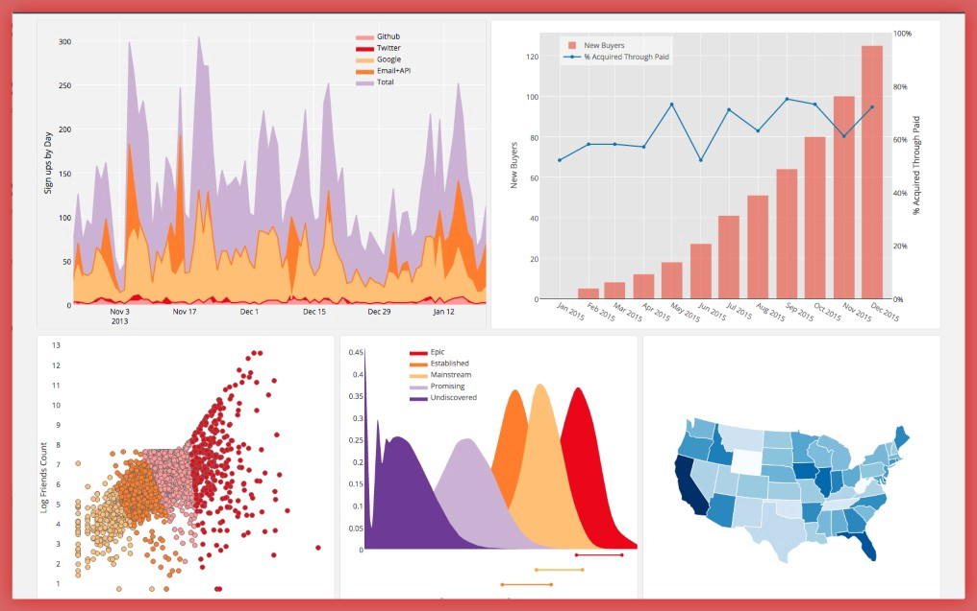
Data Visualization
confusion_matrix graph(test case)
Annotate each cell with the numeric value using integer formatting. Map contains positive and negative tweets

Slide 18
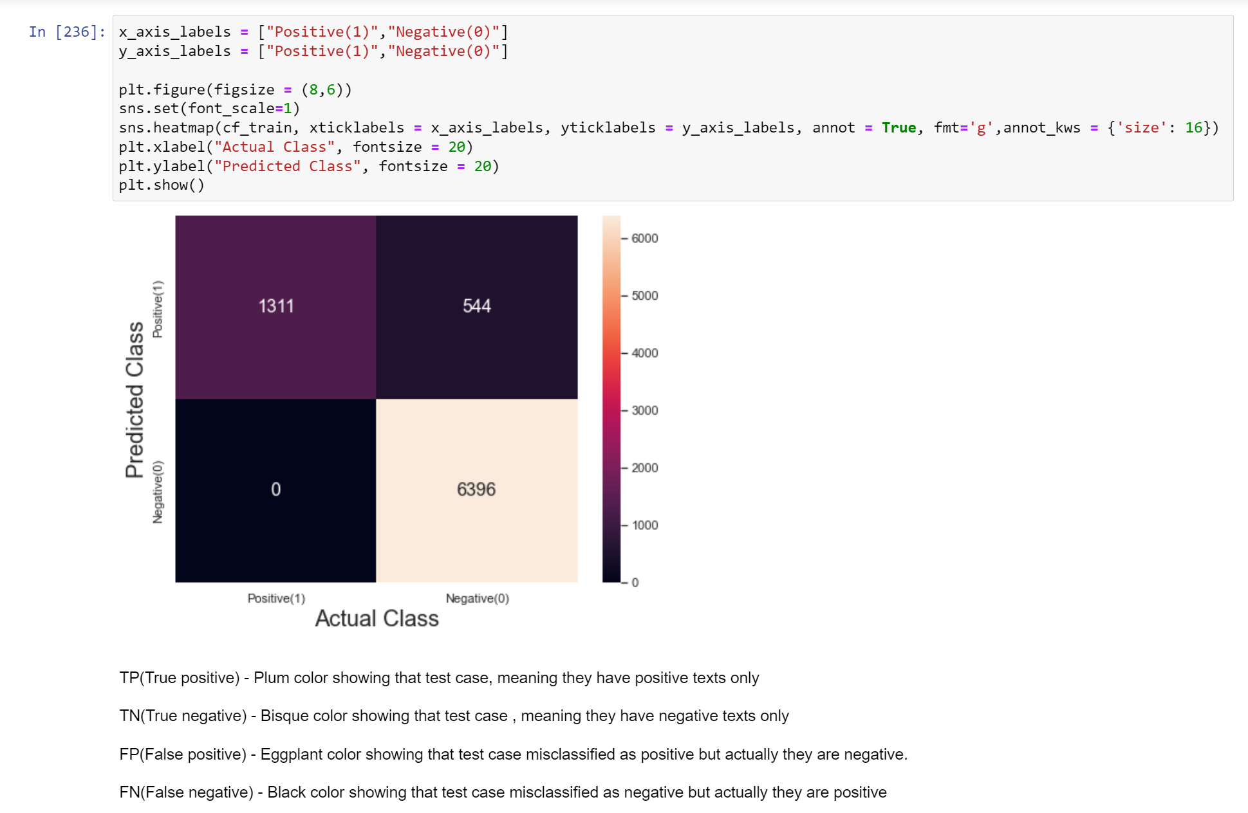
confusion_matrix graph(train case)

Slide 19
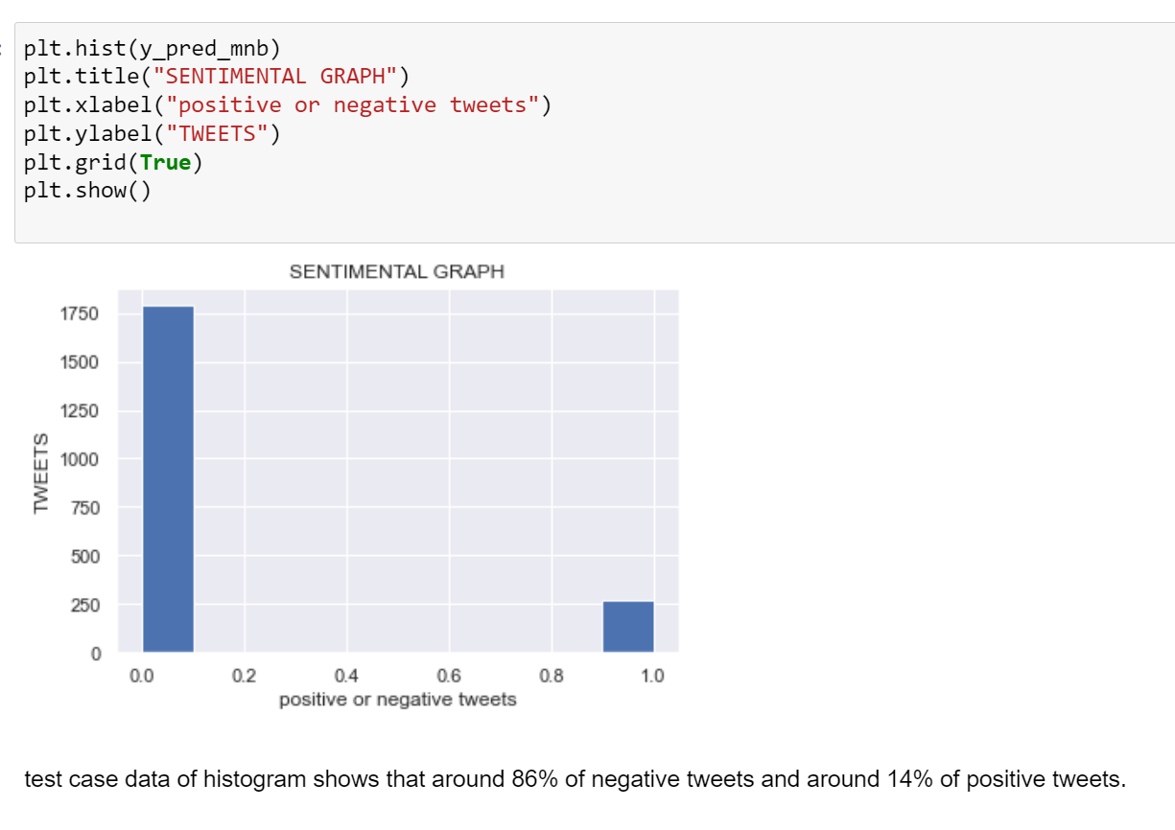
Histogram method of graph(test case) Graph showing the positive(1) tweets and negative(0) tweets

Slide 20
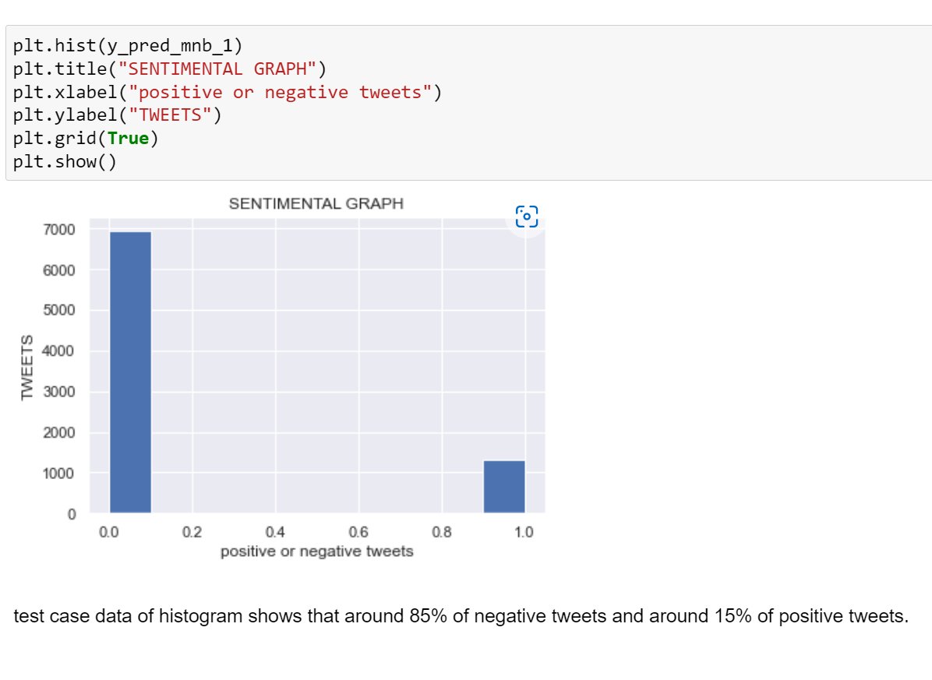
Histogram method of graph(train case) Graph showing the positive(1) tweets and negative(0) tweets

Slide 21
Result & discussion
Model accuracy_score
Test accuracy_score : 90%
Test accuracy_score : 93%
Model confusion_matrix
Test case :
Train case :
array([[ 270, 189], [ 4, 1600]], dtype=int64)
array([[1311, 544], [ 0, 6396]], dtype=int64)

Slide 22
Social sentiment is a way of measuring the emotions behind social media and other online mentions. Social sentiment can be: Positive: Consumers are enthusiastic, happy, or excited. Negative: Consumers are angry, annoyed, or frustrated.
The outcome is a numerical sentiment score for each phrase, usually on a scale of -1 (very negative) to +1 (very positive).

Slide 23
conclusion
We have seen that sentiment analysis can be used for analyzing opinions in blogs, articles, Product reviews, social media websites, movie-review websites where a third person narrates his views.
We also studied NLP and use of NLTK which approaches for sentiment analysis.
We have seen that sentiment analysis has many applications and it is important field to study

Slide 24


